Slide 1
Optimizing Random Forest with Adaptive Feature Weighting
By: Dev Makwana and Kaavya Borra

Slide 2
Our Problem
When constructing Decision Trees, the Random Forest algorithm treats all features equally.
In datasets where attributes have varying importance, it performs suboptimally.
Notes:
Kaavya

Slide 3
Our Solution
By scoring each feature based on its overall importance in the dataset, we can allow for the model to build more accurate Decision Trees, increasing the total accuracy of the model with minimal additional computation overhead and training time.
We also dynamically update these scores as the trees build to allow for more precise feature selection.
We used TPE (Tree-structured Parzen Estimator) to optimize hyperparameters for the model.
Notes:
Kaavya

Slide 4
Dataset
The Nursery Dataset
8 Features: parental situation, nursery evaluation, application form completion, number of children, housing condition, financial standing, social assessment, and health priority
Train/Test Split: 80/20
Notes:
Kaavya

Slide 5
Preprocessing
No preprocessing, because the dataset was from Kaggle
Notes:
Kaavya

Slide 6



The Baseline Model
Standard implementation of Random Forest using the scikit-learn library, using entropy loss.
Notes:
Kaavya

Slide 7


Shapely Additive Explanations (SHAP)
Calculates the average shapley value.
N is the number of instances, SHAP(x) is the Shapley value.
F is the set of all features
S is the subset of features excluding i
v(S) is the model’s predictions using only features in S
Notes:
Dev

Slide 8
Mutual Information
Calculates the entropy of the dataset before and after a transformation
Essentially the same as Info Gain
Notes:
Basically Info Gain

Slide 9
Permutation Importance
Evaluates the predictive impact of a feature by measuring accuracy difference after shuffling feature values.
Baseline Accuracy is the accuracy using the normal data
Accuracy(X) is the accuracy after randomizing the data of the feature

Slide 10
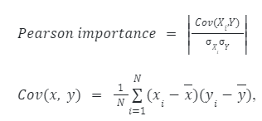
Pearson Correlation
Calculates linear relationships between features and the class

Slide 11

Variance
Used to filter out features with little variance

Slide 12
Feature Scoring Metrics
SHAP (Shapely Additive Explanations) | Non-linear relationships
Mutual Information | Classification
Permutation Importance | Overall accuracy
Pearson Correlation | Linear relationships
Variance | Filters out features
Notes:
Dev

Slide 13

Dynamic Weight Updates
We update the weights periodically, recalculating the weights using the formula:
α is the decay factor
w is the current feature weights
Φ is the current scores of the features
This allows the model to incorporate emerging feature interactions while avoiding major weight changes.

Slide 14
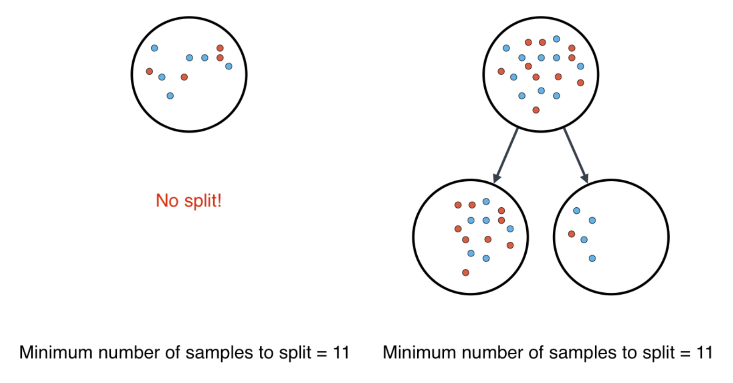
Minimum Sample Split
Extra parameter to only allowed Decision Trees to split if there is enough instances to split.
Used to possible end branches early

Slide 15
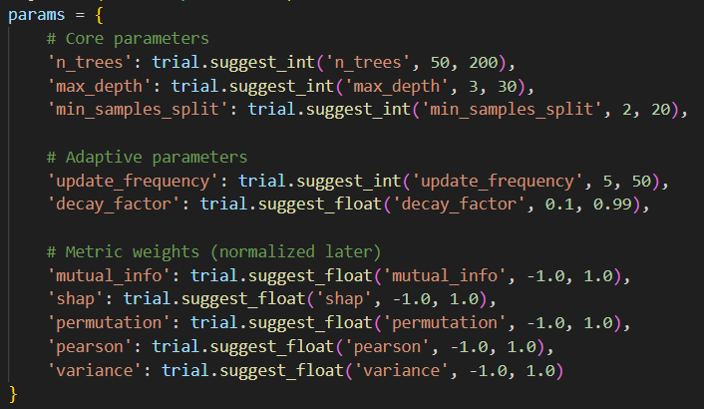
Hyperparameter Optimization
We used Optuna’s Tree-structured Parzen Estimator (TPE) to optimize 10 parameters.
TPE models the probability distribution of high-performing parameters.
We used Hyperband pruning to terminate trials that are unlikely to yield high accuracies to save computation time.

Slide 16
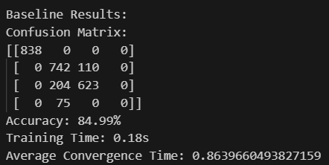
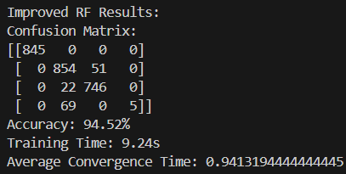
Results
Accuracy went from ~85% (standard RF) to ~95% (our RF)
Number of Trees | 84
Max Tree Depth | 25
Minimum Sample Split | 2
Update Frequency | 13
Decay Factor | 0.564037135585795
SHAP Weightage | 0.3097563418541779
Mutual Info Weightage | 0.21521438245654642
Permutation Weightage | 0.0709454962848854
Pearson Correlation Weightage | 0.1380438030555161
Variance Weightage | 0.2660399763488742
+ ~25 minutes optimization time
Notes:
Kaavya

Slide 17
Conclusion
Our improved Random Forest algorithm was more accurate but had a much longer training time.
GPU-accelerated SHAP (e.g., cuML) could reduce training time, and adjusting weight updates could help with rare classes.
Testing on more datasets would provide insights for further improvements.
Notes:
Kaavya

Slide 18
THANK YOU

